Slide 1
ZARA ESCAPES CENTRALIZED FEEDBACK SYSTEM
Presented by: Ebuka Anthony Akunedoziobi

Slide 2

Project Overview
Zara Escapes Luxury hospitality brand with 20 properties
Goal: Centralize guest feedback & improve customer experience
Suggested visual: Luxury hotel or hospitality operations image
Notes:
Introduce Zara Escapes, its luxury positioning, and why guest feedback is critical to service excellence.

Slide 3

Business Challenges
Fragmented feedback, delayed responses, limited insight
Suggested visual: Disconnected systems or siloed data illustration
Notes:
Explain the fragmented feedback problem and how it affects response time and guest satisfaction.

Slide 4
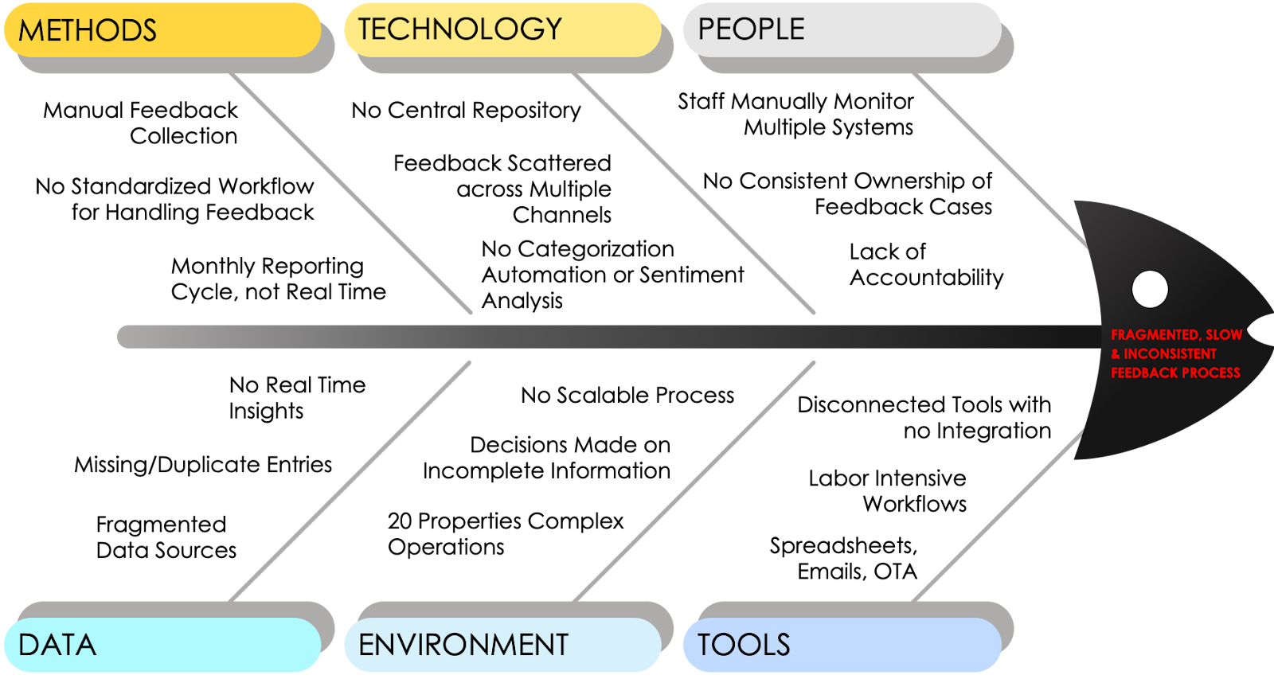
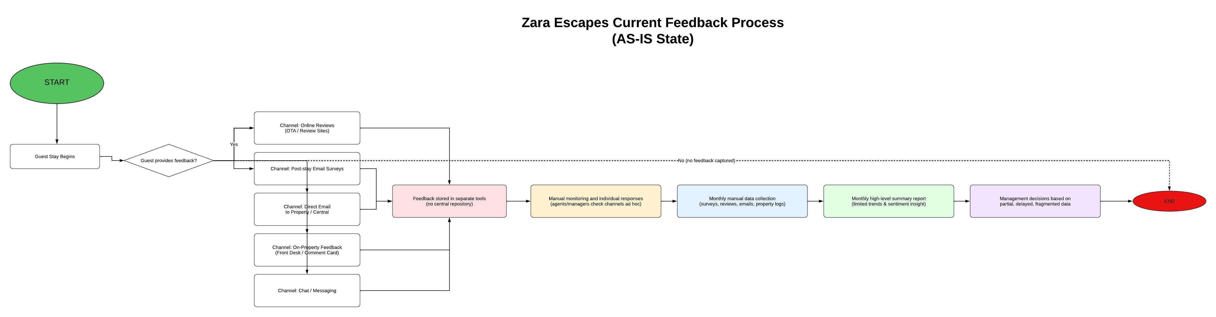
AS-IS vs TO-BE Process
Transition from manual, reactive feedback management to automated workflows
Notes:
Walk through the gap between current AS-IS processes and the desired TO-BE state.

Slide 5
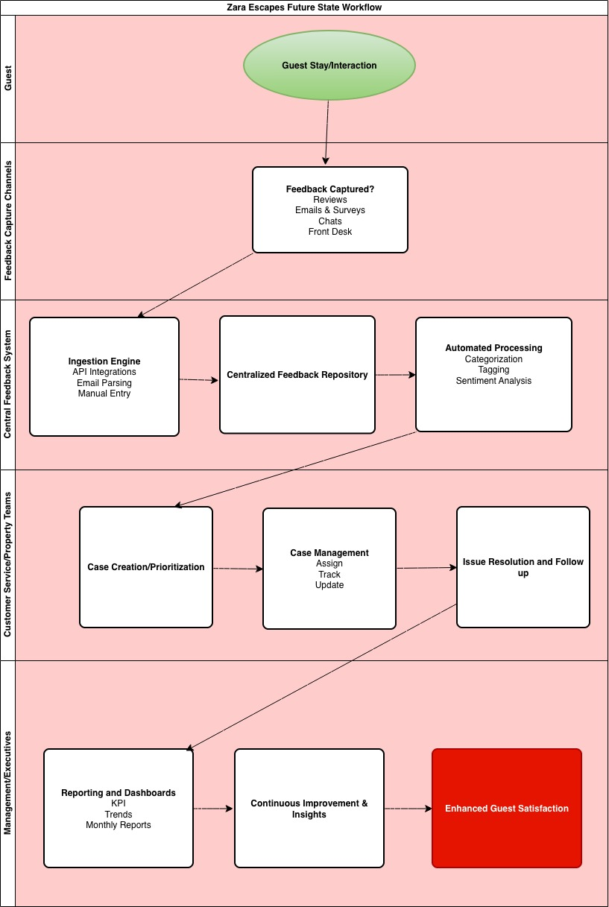
TO-BE Feedback Workflow
Multi-channel intake → analysis → alerts → resolution → reporting
Suggested visual: End-to-end feedback workflow diagram
Notes:
Explain the end-to-end TO-BE workflow from feedback intake to reporting.

Slide 6

System Features
Central repository, alerts, case management, dashboards
Notes:
Highlight the core modules that make the system functional and scalable.

Slide 7
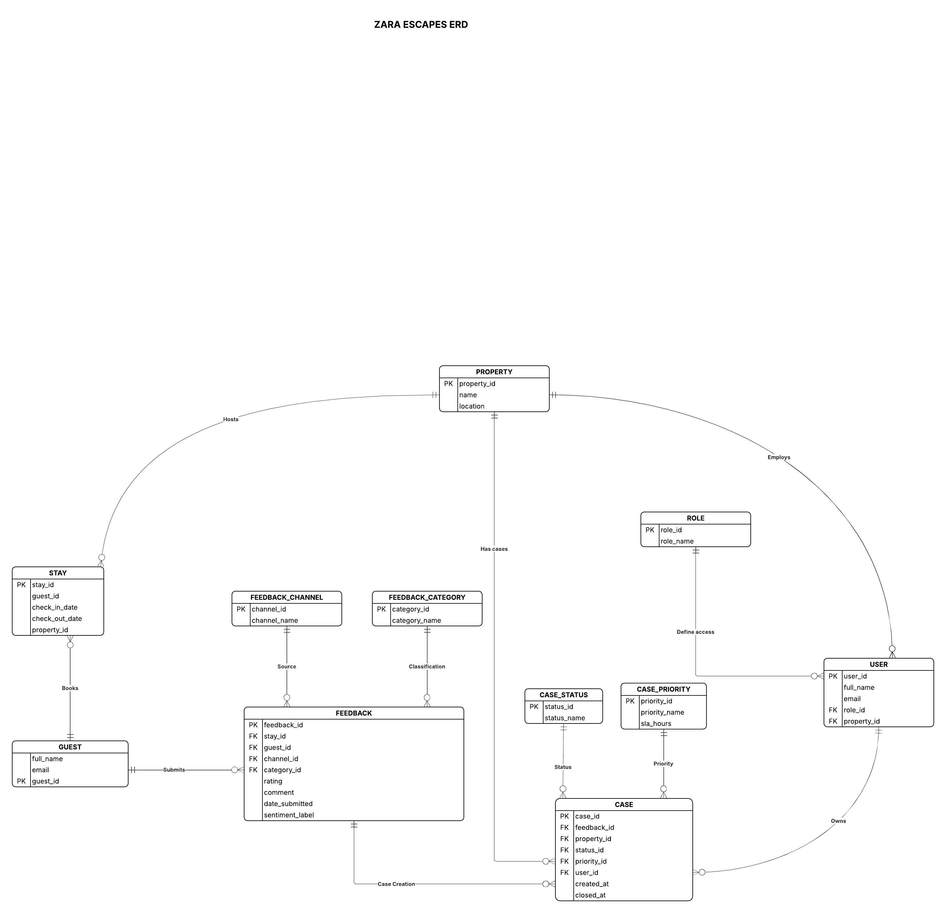
Data & Architecture Design
ERD, CRUD matrix, scalable integration architecture
 |  | Zara Escapes CRUD Matrix
 | Entity | Description | Create (C) | Read (R) | Update (U) | Delete (D)
 | GUEST | Customer who stays and provides feedback | System, Agent | Agent, PM, Ops, Exec | Agent, Admin | Admin (GDPR/compliance)
 | PROPERTY | Hotel / resort location | Admin | All roles | Admin, Ops | Admin (rare)
 | STAY | Guest stay at a property | System, Agent | Agent, PM, Ops, Exec | System, Admin | Admin (archive preferred)
 | FEEDBACK | Guest feedback record | System, Agent | Agent, PM, Ops, Exec | Agent, PM, System | Admin (compliance only)
 | FEEDBACK_CHANNEL | Source of feedback | Admin, System | All roles | Admin | Admin (deactivate preferred)
 | FEEDBACK_CATEGORY | Feedback classification | Admin, Ops | All roles | Admin, Ops | Admin (if unused)
 | CASE | Actionable ticket | System, Agent | Agent, PM, Ops, Exec | Agent, PM, Ops, System | Admin (archive preferred)
 | CASE_STATUS | Workflow status | Admin, Ops | All roles | Admin, Ops | Admin (if unused)
 | CASE_PRIORITY | Priority with SLA | Admin, Ops | All roles | Admin, Ops | Admin (if unused)
 | RESPONSE_ACTION | Case resolution actions | Agent, PM, Ops | Agent, PM, Ops, Exec | Agent, PM, Admin | Admin only
 | ALERT | System alerts | System | Agent, PM, Ops | Agent, PM, System | Admin only
 | USER | Internal system users | Admin, System | All roles (limited) | Admin, User (self) | Admin only
 | ROLE | Permission roles | Admin | Admin, Ops | Admin | Admin (if unused)
 | TEAM | Operational teams | Admin, Ops | All roles | Admin, Ops | Admin (deactivate pref.)
Notes:
Explain how data modeling and architecture support reliability and growth.

Slide 8
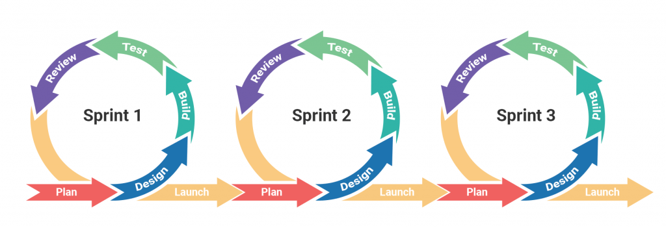
Agile Delivery Model
Epics, stories, sprints over a 3-week timeline
Notes:
Describe how Agile delivery enabled structured and timely execution.

Slide 9

Tool Recommendation
SurveyMonkey selected using cost–benefit analysis
Notes:
Explain why SurveyMonkey was selected based on cost-benefit analysis.

Slide 10
Integration Roadmap
Feedback system integrated with PMS, CRM, BI
Phase 1
Foundation & Planning
Audit systems Define data rules Design architecture
Phase 2
Data Mapping & Design
Map fields Define APIs Validate mappings
Phase 3
Integration Build
Survey ingestion PMS sync CRM updates
Phase 4
Testing & Go-Live
UAT Performance checks Deployment
Notes:
Walk through the phased integration approach to reduce risk.

Slide 11

UAT & Refinement
User testing drove key usability and reliability improvements
Notes:
Explain how UAT validated usability and drove refinements.

Slide 12
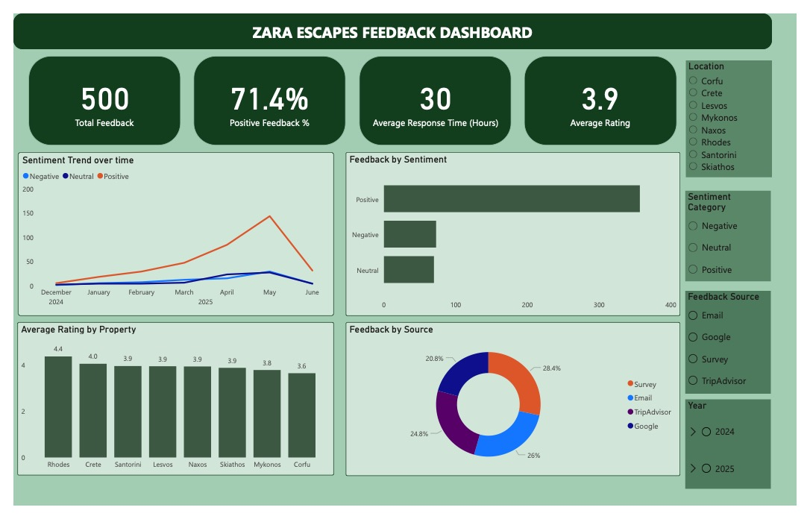
Final Prototype
Centralized dashboard enabling faster decision-making
Notes:
Demonstrate how the final dashboard empowers managers.

Slide 13

Business Value
Faster response, improved CX, consistent service quality
Suggested visual: KPI or performance improvement visual
Notes:
Link system improvements to tangible business outcomes.

Slide 14

Next Steps
Production rollout, training, continuous optimization
Notes:
Outline recommended next steps toward implementation.

Slide 15

Project ready for implementation and rollout
Notes:
Thank stakeholders and open for questions.

